Slide 1

The Power of Blockchain: Transforming the Digital Landscape
Blockchain technology is revolutionizing how we store, secure, and transfer data. By decentralizing information and creating a tamper-proof digital ledger, blockchain is empowering individuals and businesses to transact with unprecedented trust and transparency.

Slide 2

Understanding Blockchain: The Foundational Concepts
1
Decentralization
2
Cryptography
3
Transparency
Blockchain operates on a decentralized network, eliminating the need for a central authority to manage and verify transactions.
Advanced cryptographic techniques ensure the security and integrity of data stored on the blockchain.
The distributed ledger provides a transparent and immutable record of all transactions, enhancing trust and accountability.

Slide 3
Blockchain Applications: Use Cases Across Industries
Financial Services
Supply Chain Management
Healthcare
Blockchain revolutionizes international payments, remittances, and asset trading with faster, more secure, and cost-effective transactions.
Blockchain enhances transparency and traceability, enabling real-time tracking of goods and reducing the risk of fraud.
Secure and decentralized storage of patient records, streamlining data sharing and improving patient outcomes.

Slide 4

Cryptocurrency and the Blockchain: A Symbiotic Relationship
Bitcoin
Ethereum
The first and most well-known cryptocurrency, built on the blockchain technology to facilitate peer-to-peer digital transactions.
A decentralized blockchain platform that enables the creation and execution of smart contracts and decentralized applications.
Altcoins
DeFi
Numerous other cryptocurrencies that have emerged, each with their own unique features and use cases.
Decentralized finance applications built on blockchain, offering innovative financial services without traditional intermediaries.

Slide 5
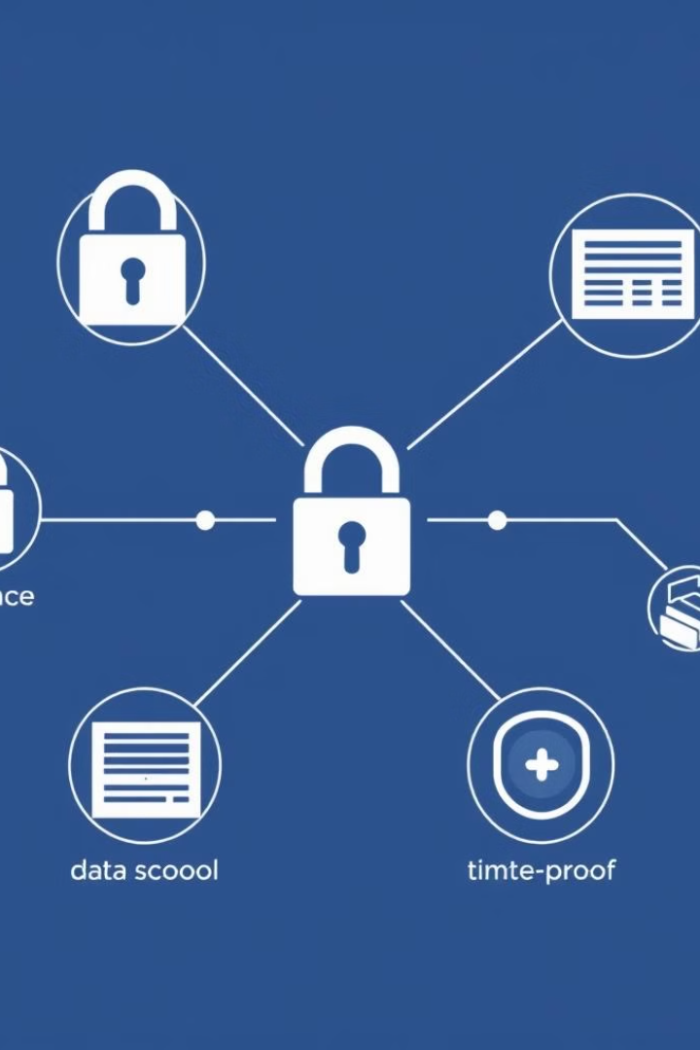
Blockchain and Data Security: Enhancing Trust and Transparency
1
Cryptography
Blockchain leverages advanced cryptographic techniques to secure data and validate transactions.
2
Distributed Ledger
The decentralized nature of the blockchain eliminates single points of failure, improving data integrity.
3
Immutability
Once a transaction is recorded on the blockchain, it becomes virtually impossible to alter or delete, enhancing transparency.

Slide 6
Blockchain Adoption: Challenges and Best Practices
Scalability
Regulation
Interoperability
Increasing the transaction throughput and processing speed of blockchain networks to meet growing demand.
Navigating the evolving legal and regulatory landscape to ensure compliance and foster mainstream adoption.
Enabling seamless integration and data exchange between different blockchain networks and legacy systems.

Slide 7




The Future of Blockchain: Innovations and Emerging Trends
Quantum Computing
Advancements in quantum computing could revolutionize blockchain security and performance.
AI and Machine Learning
Integrating AI and ML algorithms to enhance data analysis and decision-making on blockchain platforms.
IoT and Edge Computing
Leveraging blockchain to secure and streamline data management in the Internet of Things ecosystem.

Slide 8

Conclusion: The Blockchain Revolution
Blockchain technology is poised to transform the digital landscape, empowering individuals and businesses to transact with unprecedented trust, transparency, and efficiency. As the ecosystem continues to evolve, the potential of blockchain to disrupt industries and reshape the future is truly boundless.

